Slide 1
Data Ingestion
From Blob Storage

Slide 2
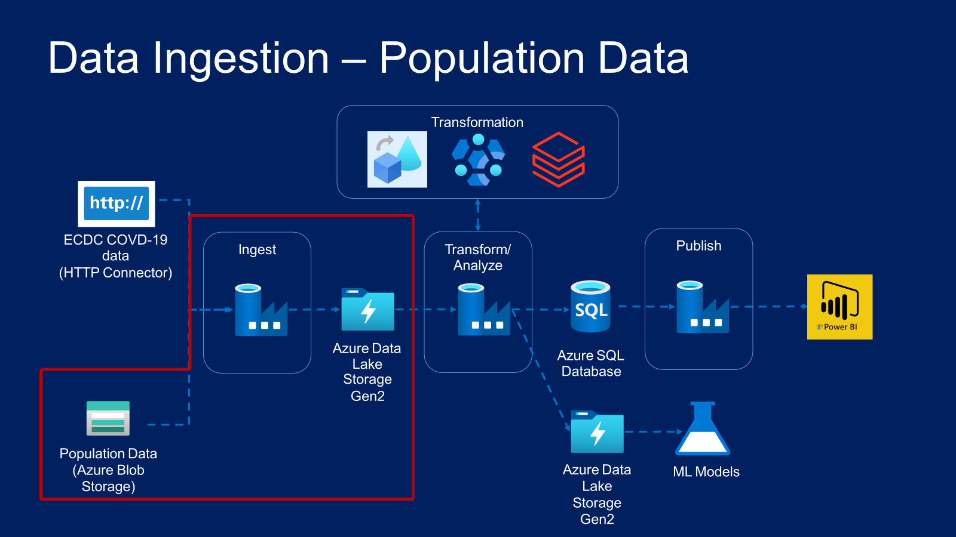


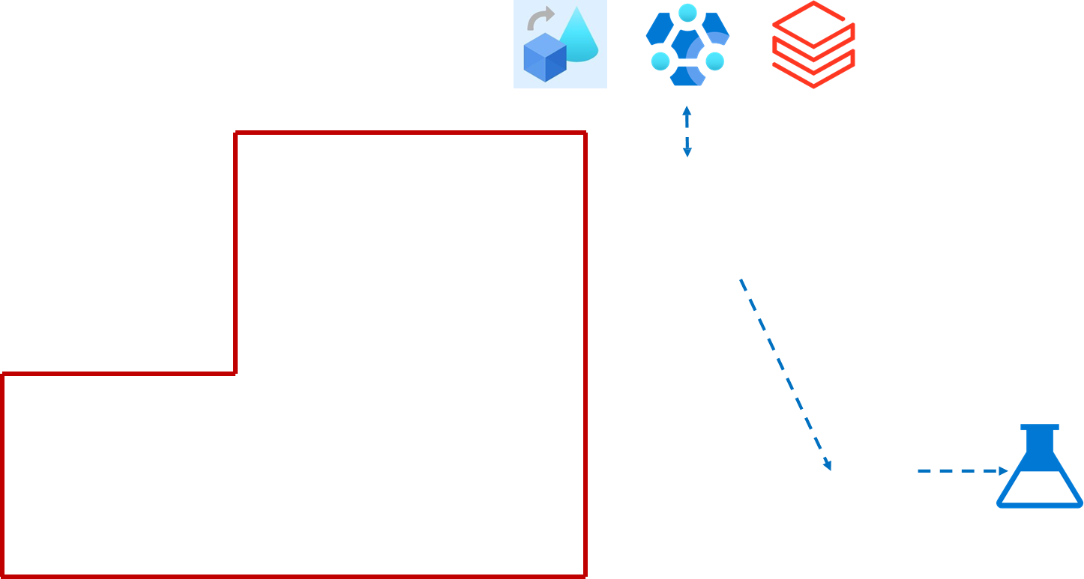
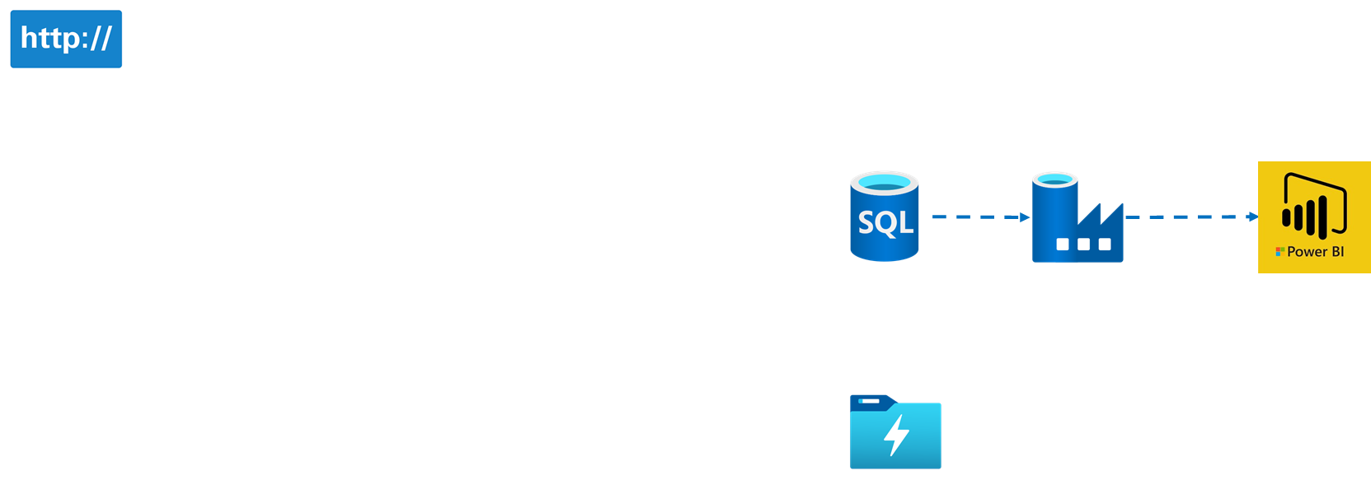
Data Ingestion – Population Data

Slide 3
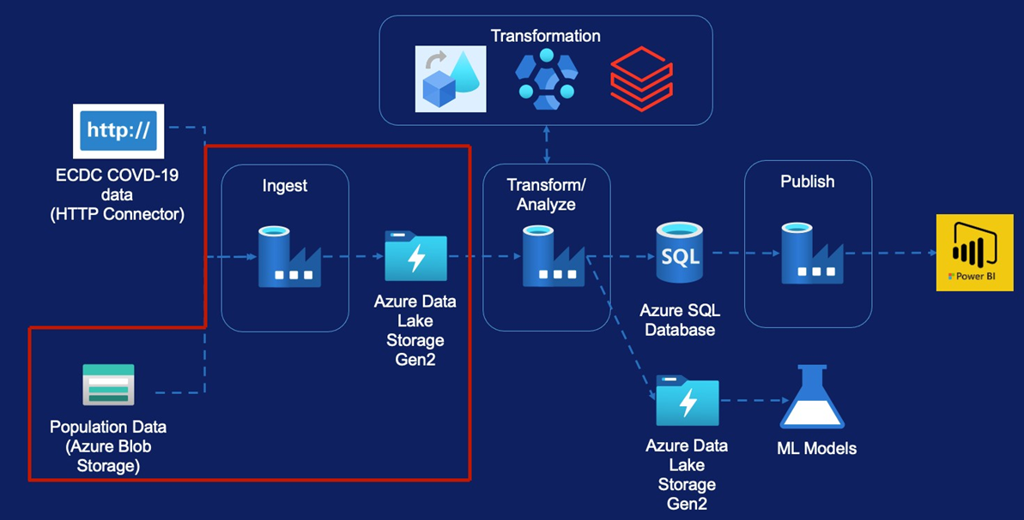
Data Ingestion – Population Data
Copy Activity
Linked Services
Datasets Pipeline
Validation Activity
If Condition Activity
Web Activity
Get Metadata Activity
Delete Activity
Trigger

Slide 4

Copy Activity
Azure Blob Storage
Azure Data Lake
Ingest ”population by age” for all EU Countries into the Data Lake to support the machine learning models to predict increase in Covid-19 mortality rates

Slide 5
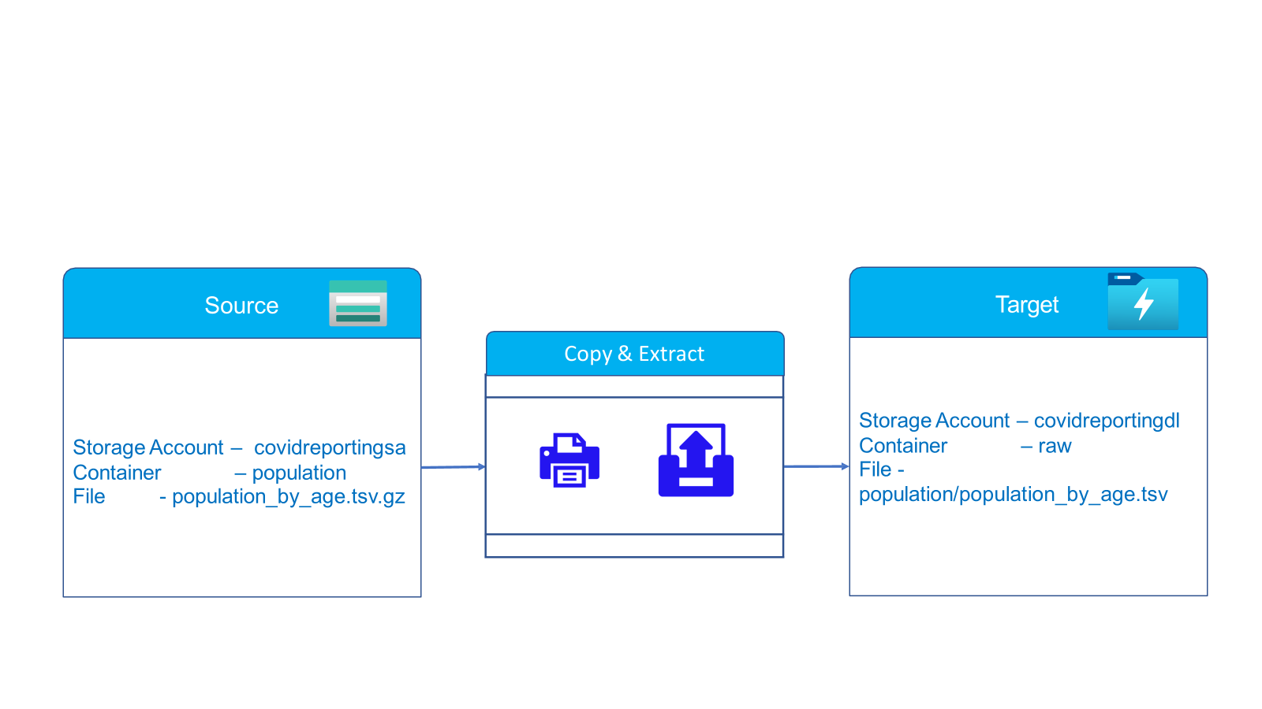

Slide 6
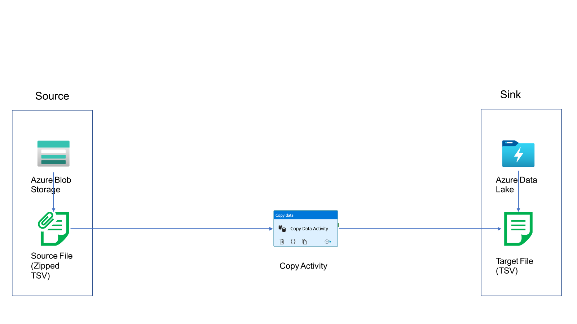
Copy Activity

Slide 7
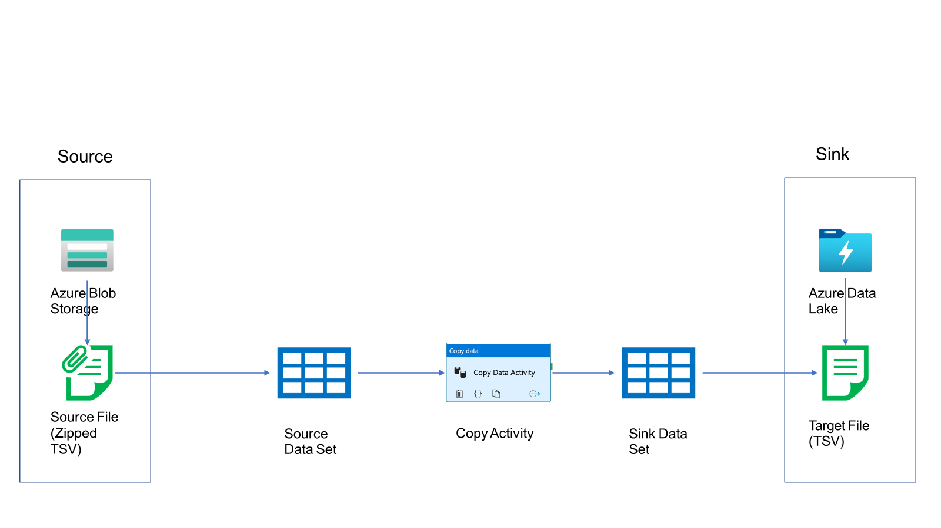

Slide 8
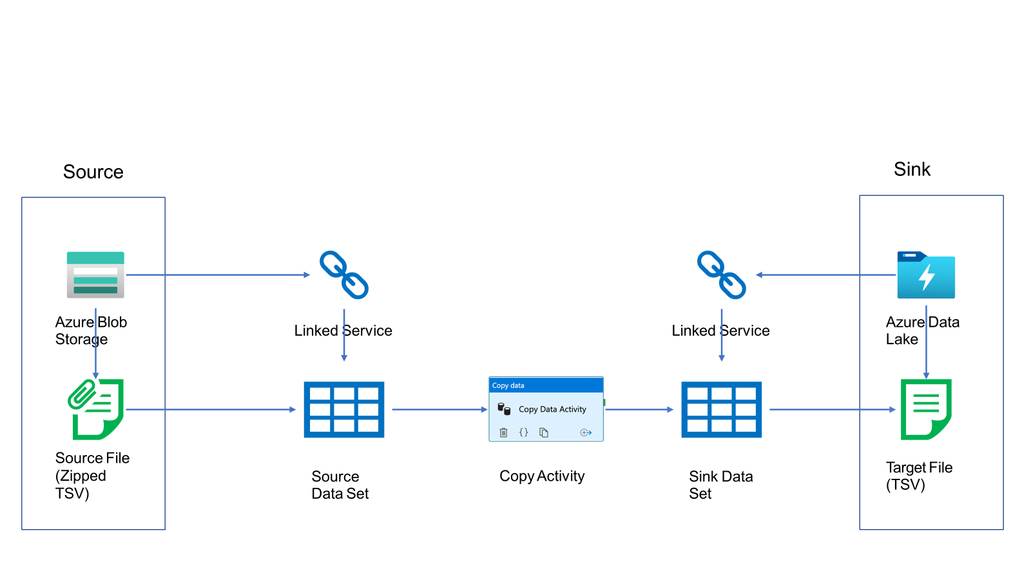

Slide 9
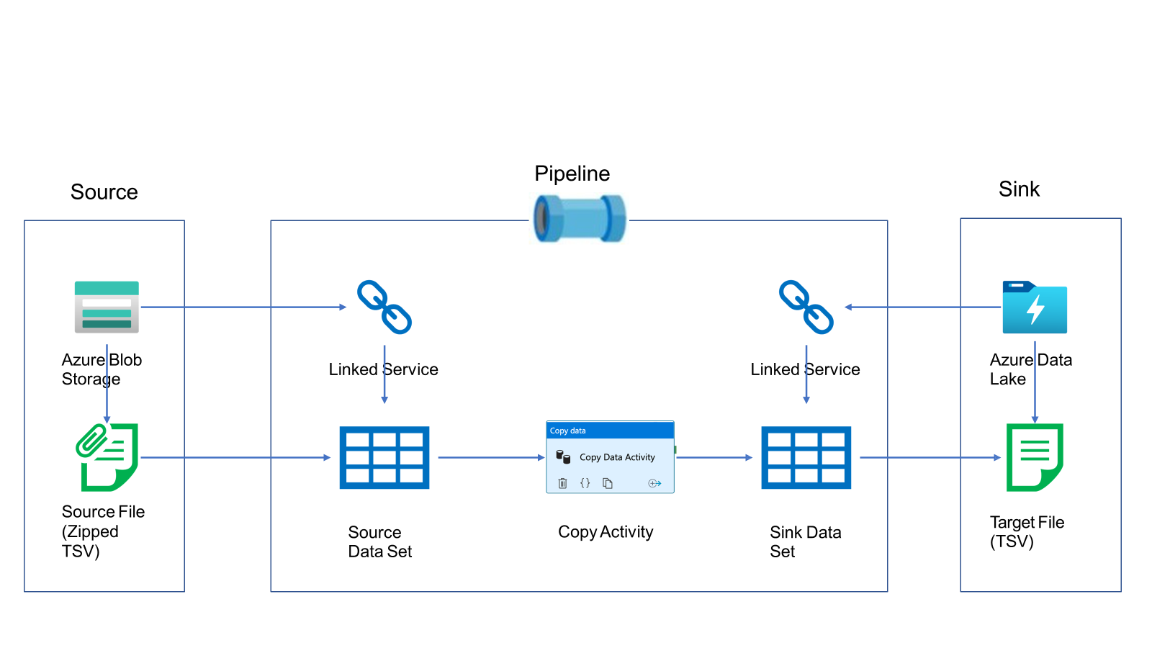
Copy Activity

Slide 10
Copy Activity From Azure Blob Storage

Slide 11
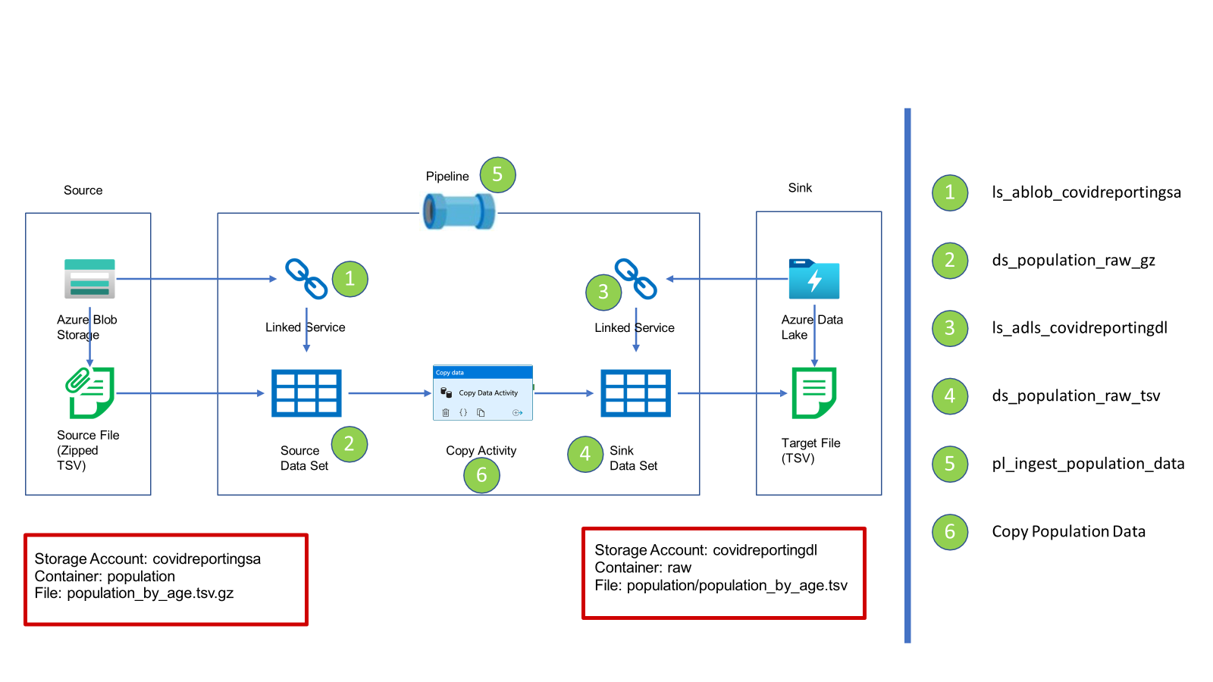
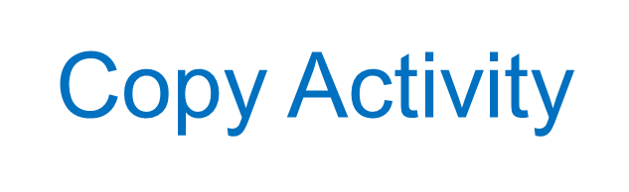

Slide 12
Handling Real World Scenarios
Scenario 1: Execute Copy Activity when the file becomes available
Scenario 2: Execute Copy Activity only if file contents are as expected
Scenario 3: Delete the source file on successful copy

Slide 13
Scheduling Pipeline Execution

Slide 14



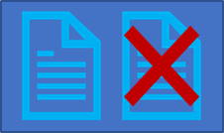
Schedule Trigger
Tumbling Window Trigger
Triggers
Event Trigger

Slide 15

Runs on a calendar/ Clock
Supports periodic and specific times
Trigger to Pipeline is Many to Many
Schedule Trigger
Can only be scheduled for a future time to start

Slide 16

Runs at periodic intervals
Windows are fixed sized, non-overlapping
Can be scheduled for the past windows/ slices
Trigger to Pipeline is one to one
Tumbling Window Trigger

Slide 17
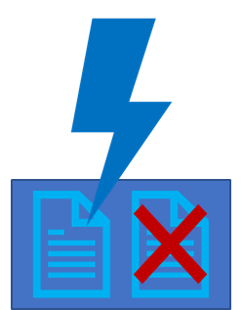
Runs in response to events
Events can be creation or deletion of Blobs/ Files
Trigger to Pipeline is Many to Many
Event Trigger

Slide 18
Thank You

